Slide 1


School of Computing Science and Engineering
Course Code : R1UC604C Course Name: Deep Learning
Training Deep Neural Networks
Name of the Faculty: Dr. Sandeep Kumar M Program Name: B.Tech

Slide 2
Outline
Difficulty of Training Deep Neural Networks
Greedy Layer Wise Training
Name of the Faculty: Dr. Sandeep Kumar M Program Name: B.Tech

Slide 3
Challenges in Training deep neural networks
Vanishing and exploding gradients: as the network depth increases, it can become increasingly difficult to train the model because of the vanishing and exploding gradient problem. This can make it challenging to update the weights of the network effectively during training.
Overfitting: deep neural networks have a large number of parameters, which can make them prone to overfitting the training data. This means that the model performs well on the training data but fails to generalize to new, unseen data.
Computational resources: training deep neural networks requires a significant amount of computational resources, including processing power and memory. This can make it expensive and time-consuming to train large models on large datasets.
Name of the Faculty: Dr. Sandeep Kumar M Program Name: B.Tech

Slide 4
Challenges in Training deep neural networks
Hyperparameter tuning: deep neural networks have many hyperparameters that need to be carefully tuned in order to achieve good performance. This process can be time-consuming and requires a good understanding of the model and the dataset.
Data preprocessing: deep neural networks often require large amounts of data for training. Preprocessing this data, including cleaning, normalization, and feature engineering, can be time-consuming and error-prone.
Overall, training deep neural networks can be challenging due to the complexity of the models, the need for large amounts of data, and the computational resources required.
However, with careful attention to these factors and the right techniques, it is possible to train deep neural networks effectively and achieve good performance on a variety of tasks.
Name of the Faculty: Dr. Sandeep Kumar M Program Name: B.Tech

Slide 5
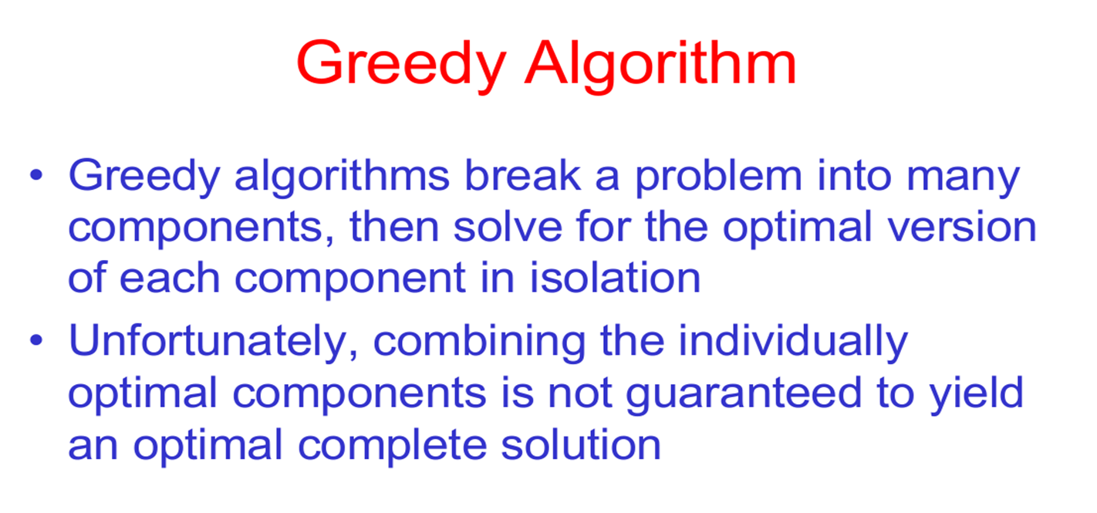
Greedy Algorithm
Name of the Faculty: Dr. Sandeep Kumar M Program Name: B.Tech

Slide 6
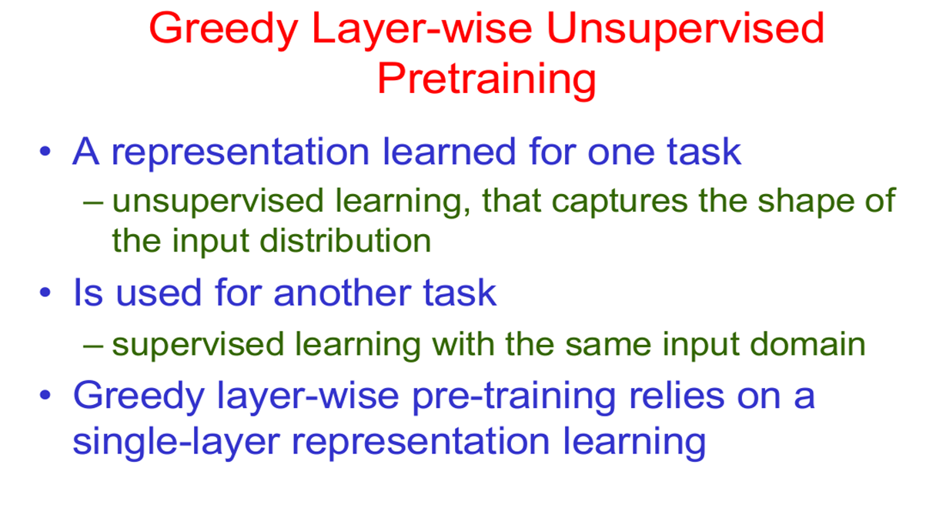
Greedy Layer-wise Unsupervised Pretraining
Name of the Faculty: Dr. Sandeep Kumar M Program Name: B.Tech

Slide 7
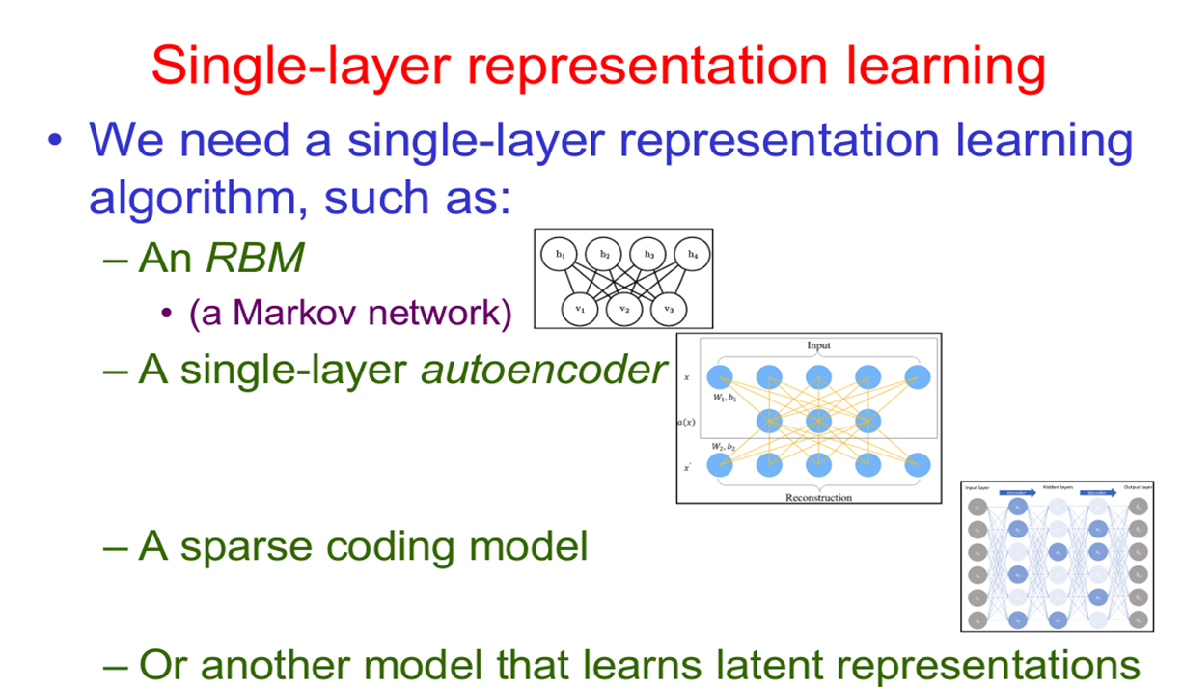
Single-Layer representation learning
Name of the Faculty: Dr. Sandeep Kumar M Program Name: B.Tech

Slide 8
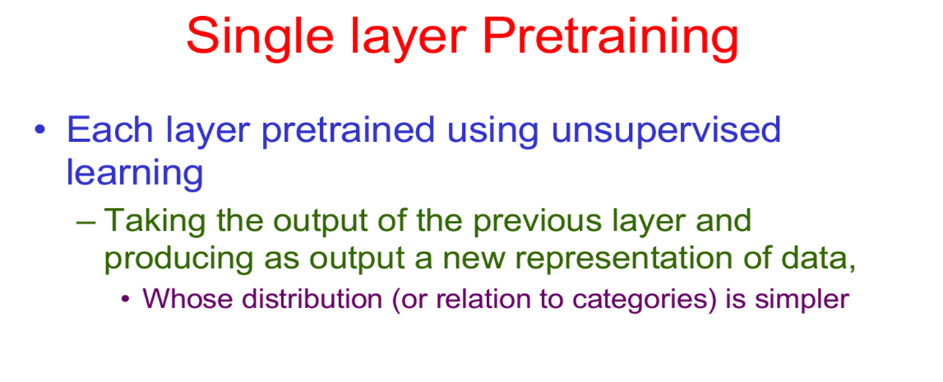
Single layer Pretraining
Name of the Faculty: Dr. Sandeep Kumar M Program Name: B.Tech

Slide 9
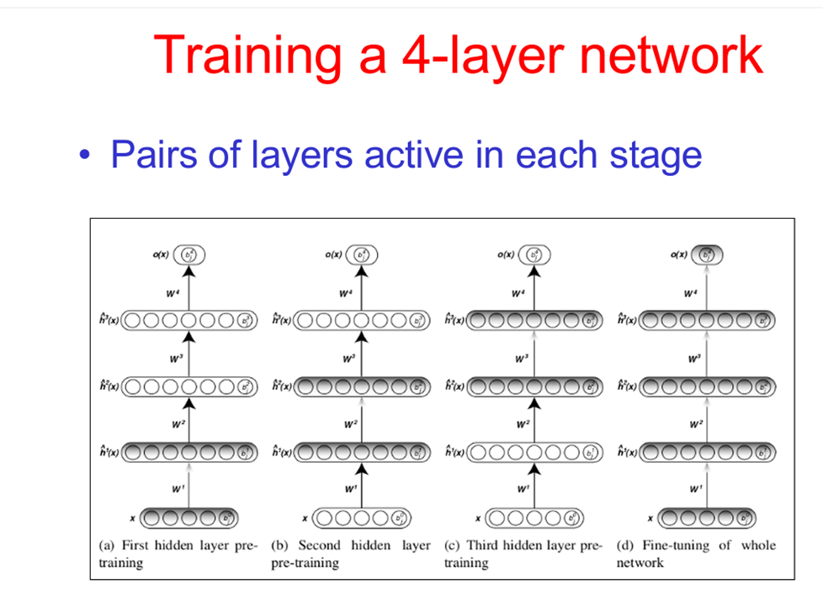
Training a 4-Layer network
Name of the Faculty: Dr. Sandeep Kumar M Program Name: B.Tech

Slide 10
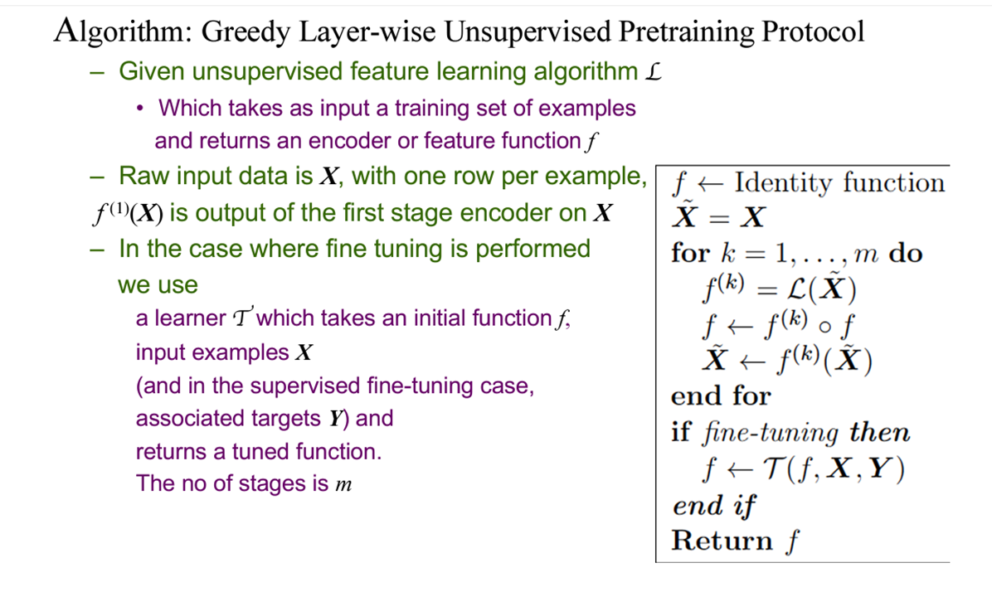
Algorithm-Greedy layer-wise
Name of the Faculty: Dr. Sandeep Kumar M Program Name: B.Tech

Slide 11
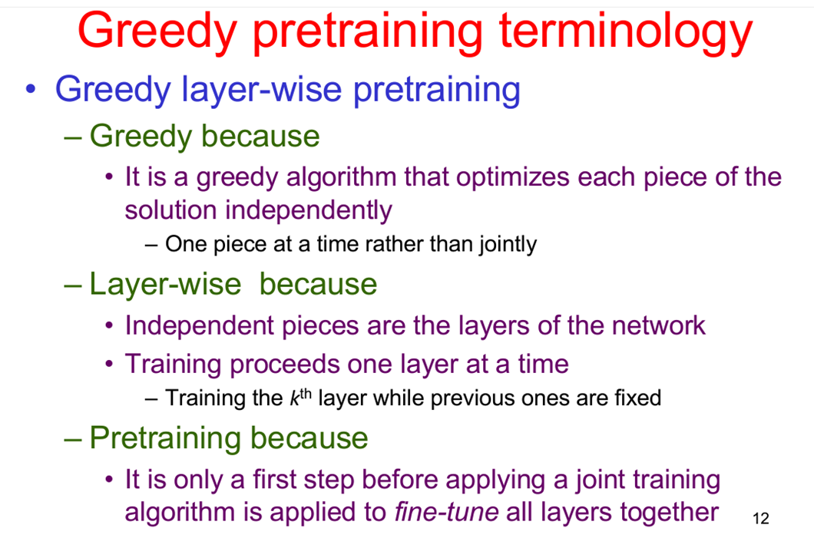
Greedy pretraining terminology
Name of the Faculty: Dr. Sandeep Kumar M Program Name: B.Tech

Slide 12
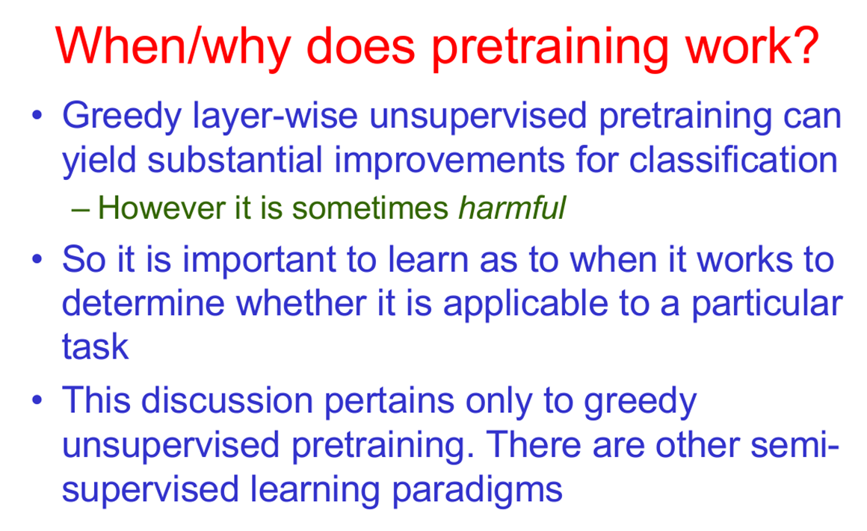
When/why does pretraining works
Name of the Faculty: Dr. Sandeep Kumar M Program Name: B.Tech

Slide 13
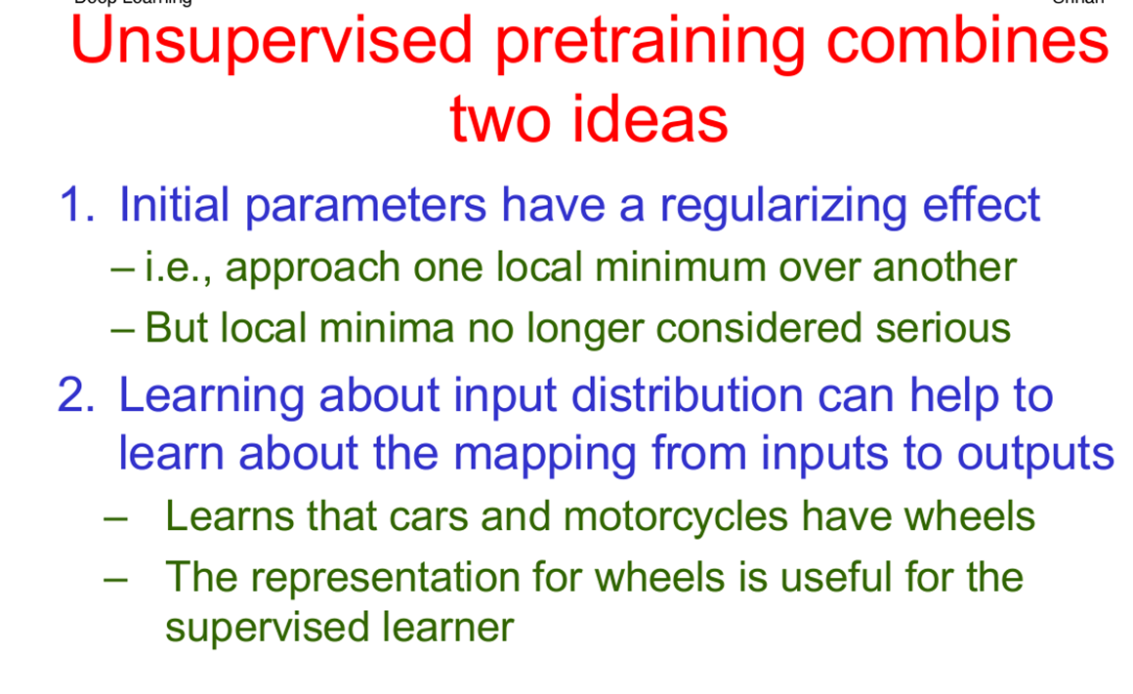
Unsupervised pretraining combines
Name of the Faculty: Dr. Sandeep Kumar M Program Name: B.Tech

Slide 14
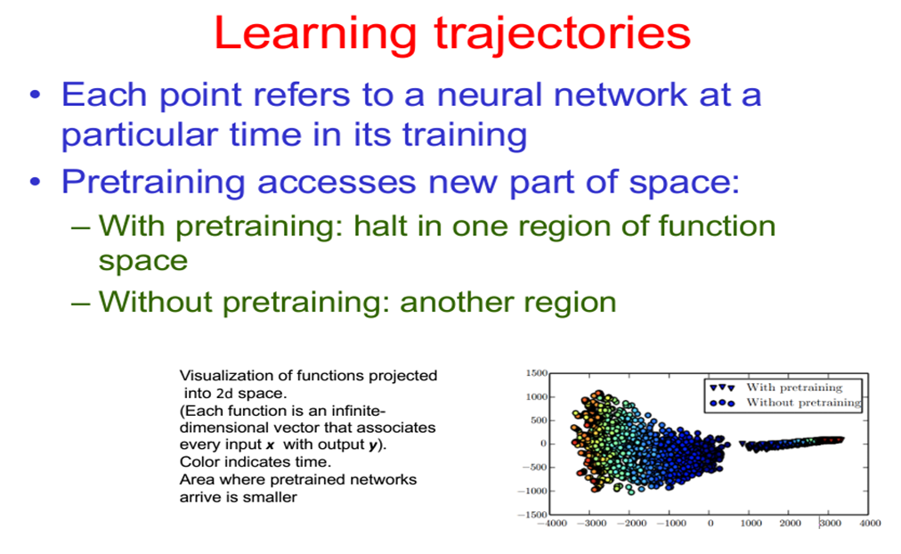
Learning trajectories
Name of the Faculty: Dr. Sandeep Kumar M Program Name: B.Tech

Slide 15


